Slide 1
FHSA Parent Testing Meeting
2020 – 2021
Policies, Test Administration, & Support

Slide 2
Today’s Agenda
✚ Policies & Test Windows
✚ Remote Testing
✚ Testing Preparation

Slide 3
NWEA Map Reading Fluency
K-2 ONLY
Administered Tuesday, September 15th at 8am
Take recess breaks and specials as scheduled
The session will be open the entire day
Roughly 45 minute assessment maximum
Student username is email address and password is grow.

Slide 4
Testing Policies
Kindergarten – 8th Grade

Slide 5
Assessment Purpose
These assessments are not high-stakes or used for grades.
These assessments are tools that provide information to teachers so they can best determine what content and skills your child is ready to learn.

Slide 6
K-2 REQUIREMENTS
§6-15-2907. Statewide student assessment system
(a) The Department of Education shall implement a statewide student assessment system to be administered by Arkansas public schools on a schedule determined by the State Board of Education that includes the following components:
(1) Developmentally appropriate measurements or assessments for kindergarten through grade two (K-2) in literacy and mathematics;

Slide 7
Testing Dates
 | NWEA: MAP Growth
Fall | 9/18 Mock Test; 8:00 9/21 Reading K-8; 8:00am 9/22 Math 3-8; 8:00am 9/23 No Testing 9/24 Science 3-8; Math K-2; 8:00am 9/25 MU
Winter | December 1-7 (3rd - 8th) January 11 - 14 (K-2)
Spring | March 1 - 5 (3rd - 8th) May 3 - 6 (K - 2)

Slide 8
Test | Topic | Question | ADE Answer
All | Test Security | Can teachers help students log on to the test? | Yes, teachers may help students login to the test. Only the student should proceed past the login screen.
All | Test Administration | Can a teacher help a student navigate the online system during testing? | Use the practice items prior to testing day to help students become familiar with the testing environment. During the test, no. Teachers may redirect or remind the student to hit the proper button to proceed to the next question. No assistance with choosing the correct answer should be provided.
All | Test Administration | Can test administrators place a tactile object on a student's mouse to help students know which button to use? | Yes, this will not be considered cueing.
All | Accommodations | Can an IEP or 504 team exempt a student from K-10 testing? | Yes.
All | Test Administration | Can we give scratch paper to students? | Yes. The used paper should be recycled or disposed of after the assessment.
All | Test Administration | Can we provide a physical calculator to students? | No, some items may have an embedded calculator available within the system.
All | Test Administration | What are students allowed to do once they finish testing? | Campus decision

Slide 9
Adaptive Testing Design
Testing for growth vs. testing for mastery of content
By design, students will get 25-50% of the test items incorrect.
The test “learns and adjusts” to what a students gets right and what a student gets wrong. Both are needed to identify a student’s performance.
Students are not expected to know all the answers.
MAP Growth Practice Tests September 18th starting at 8:00
test.mapnwea.org (or use the app)
Select- Try the Practice Test
Log-in- username: grow password: grow
Complete information
Practice Test should load

Slide 10
Testing Times
NWEA MAP Growth may take approximately 45 minutes per content area (Reading, Math, and Science)
At Grades K-2 it is recommended to pause the test after 20 minutes to provide young students a 10 minute break in testing.
You may also test in 15 minute increments during one tested subject and provide a 5 minute break before resuming the test after the breaks.
Grades 3-8 will take breaks as teacher directs if need

Slide 11
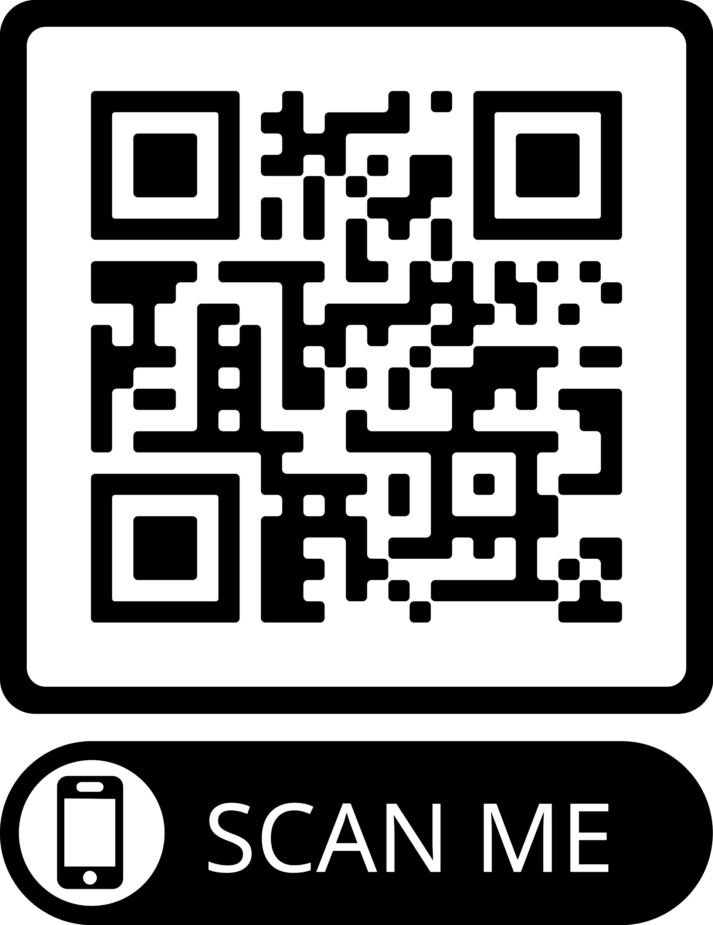
K-10 REQUIREMENTS
K-10 Test Administrators
Must sign the 2020-2021 Test Security Agreement for K-8 Assessments
Yours is found on the FHSA Website in a Google Survey format
Every K-8 student must have a signed form..

Slide 12
REMOTE TESTING

Slide 13
3 Key Considerations
for Remote MAP Growth Testing
01
Pre-Test Communication
02
Test Administration
03
Test Integrity & Data Usage
Purpose of test
Parent / Guardian involvement
Device requirements & how to access the test
Testing dates & times
Communication platform (Zoom during testing)
Student devices
Using the standard test browser https//test.mapnwea.org
Remote troubleshooting
Proctors are integral to live test proctoring
Data can be used for informing instruction

Slide 14
REMOTE TESTING TECHNICAL REQUIREMENTS
Charged devices
Access to internet
Headphones if needed
Teachers may send passwords by posting them in Schoology.
A testing Mock Day will be held on September 18th at 8am

Slide 15
Testing Preparation

Slide 16
Test Assignments
✚ Kindergarten-1st Grades
Growth: Math K-2 AR 2016
Growth: Reading K-2 AR 2016
✚ 2nd Grade
Growth: Math K-2 or 2-5 AR 2016
Growth: Reading K-2 or 2-5 AR 2016
✚ 3rd-5th Grades
Growth: Math 2-5 AR 2016
Growth: Reading 2-5 AR 2016
✚ 6th -8th Grades
Growth: Math 6+ AR 2016
Growth: Reading 6+ AR 2016

Slide 17
Student Preparation
✚ Intro to MAP Testing Script
“Some questions will be easy, and others will be more difficult. You cannot get all the answers correct, but that is okay.”
“Before you finish a question, you may change your mind and pick a different answer. But, once you move to the next question, your answer is locked, and you cannot go back to the question you have already answered.”

Slide 18
Student Engagement
Addr essi ng R api d Guessi ng
✚ Rapid guessing is a form of test disengagement and mitigating it will improve student test engagement.
✚ MAP Growth features will help students try their best and reveal when they don’t so educators have the best data available to make critical decisions.

Slide 19
Test Engagement
✚ Test will automatically pause when a student has rapidly guessed on multiple questions.
✚ Test will automatically pause two to three times during a test session.
✚ Proctor is also notified on the proctor console.
✚ Proctor can reengage and resume test (from student device or proctor console) or suspend the test.

Slide 20
Student Resources
✚ Student Resources
Overview Video
Explore Tools (2+ only)
Practice Test
✚ Username: grow
✚ Password: grow
✚ Can be accessed from secure browser or by going to https://start.nwea.org

